Slide 1

Data Analysis of Sales for AdventureWorks
Prepared by : Phionah Nakakeeto
Role : Data Analyst
Company Name : Affluent Analytica
Client Name : AdventureWorks
August 31, 2022
Notes:
I work as a Senior data analyst for Affluent Analytica, an independent analytics firm that is contracted by AdventureWorks to provide actionable insights into their business operations.
This project is about performing diagnostic and descriptive analytics on the company sales.

Slide 2
Project Overview
The purpose of this project is to analyze the Sales of AdventureWorks and to provide actionable insight based on the analysis.
The data is retrieved from AdventureWorks2019 SQL Server database with a focus on Sales and Production data for the year 2013. The 3 tables being used are Product, SalesOrderDetail, and SalesOrderHeader.
Notes:
I have established a connection to retrieve data from the AdventureWorks2019 SQL Server database into Rstudio to perform aggregations and statistical analysis.

Slide 3
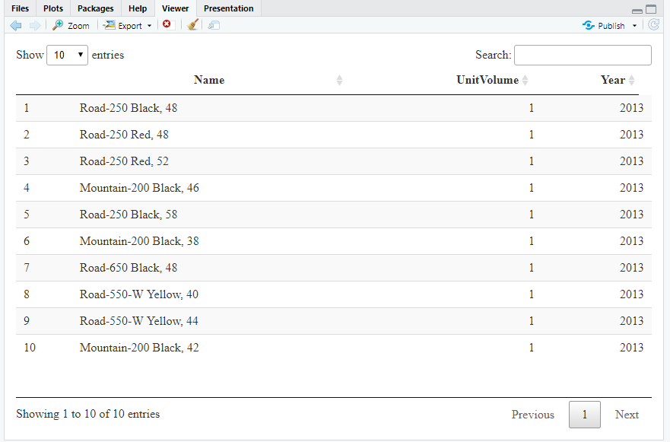
Top 10 Products By Unit Volume
Notes:
I joined 3 tables to retrieve this data. The product name is from product, unit volume (Order quantity) from salesorderdetail based on the Order date which is the year 2013.
The date information is from salesorderheader.

Slide 4
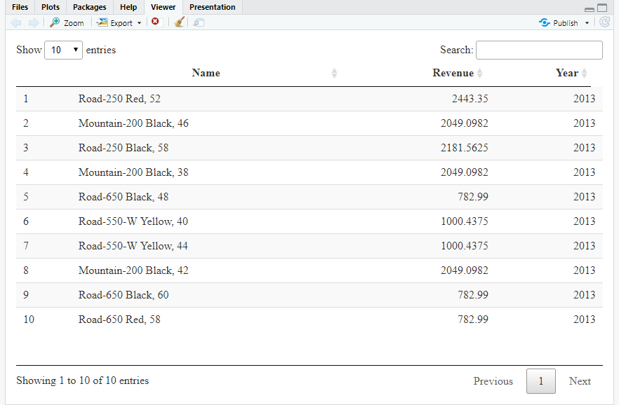
Top 10 Products by Sales Revenue
Notes:
I still joined 3 tables to retrieve revenue data (List price) i.e., product, salesorderdetail, and salesorderheader.

Slide 5
Summary Statistics for 2013 Orders
Mean 3452.68
Median 635.35
Minimum 1.52
Maximum 187487.83
25th Quartile 50.77
75th Quartile 2410.63
Notes:
These are the summary statistics for the order amount (Total due) for all orders in 2013

Slide 6
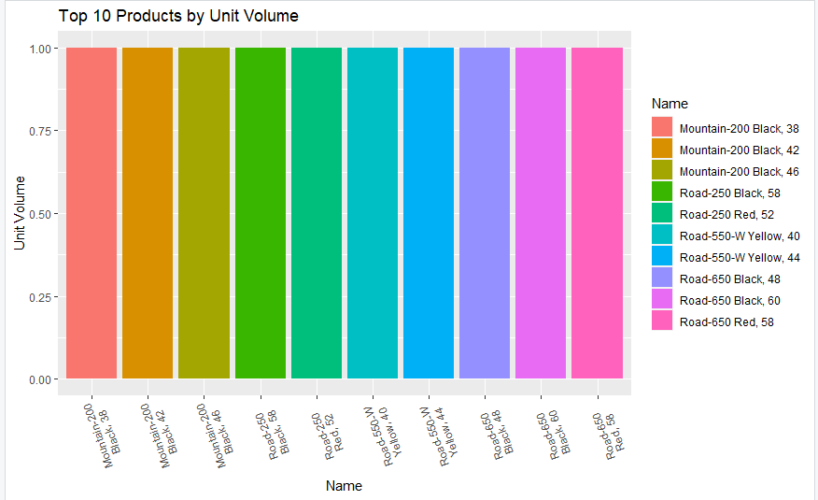
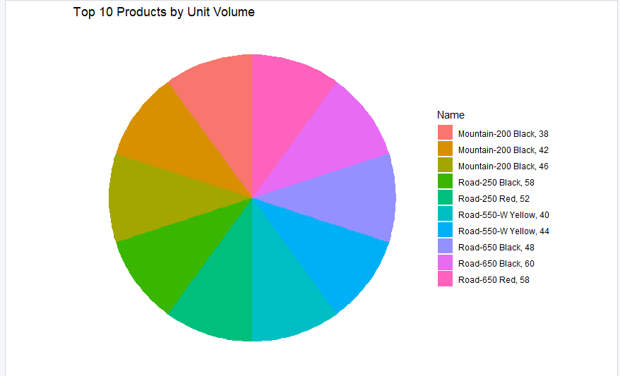
Top 10 Products by Unit Volume

Slide 7
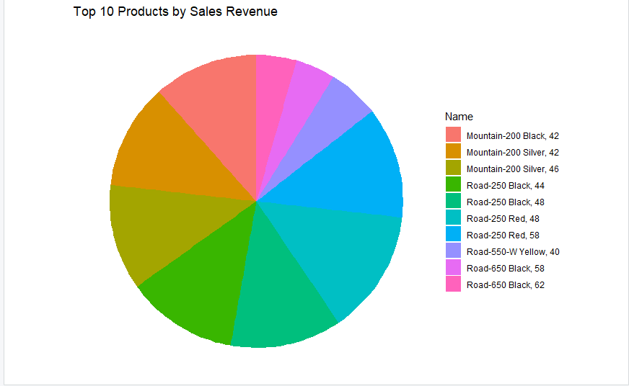
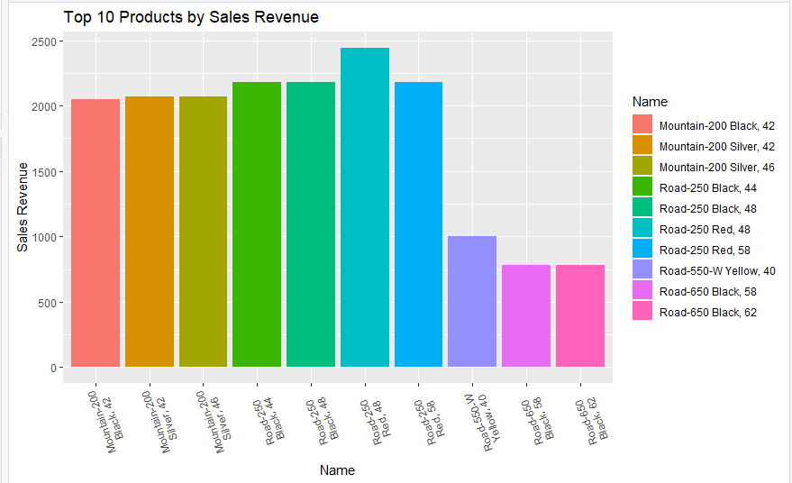
Top 10 Products By Sales Revenue - Visuals

Slide 8
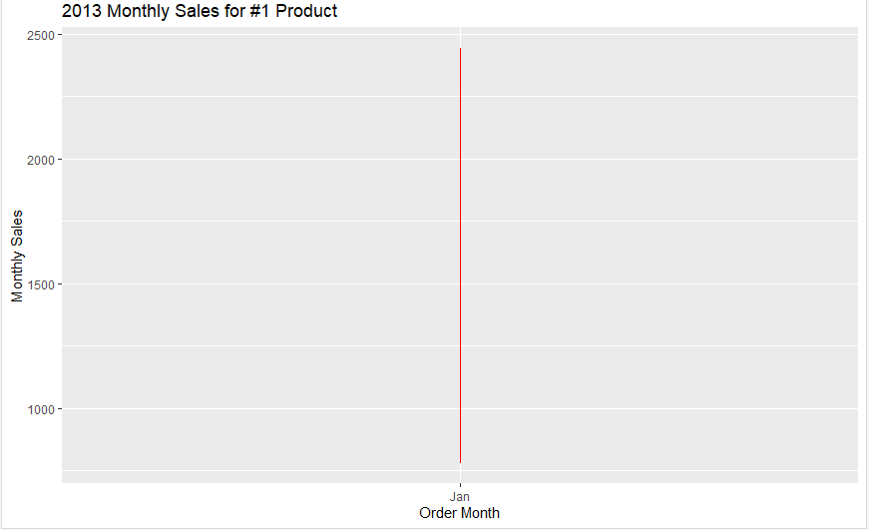
Monthly sales for #1 Product - Line chart

Slide 9
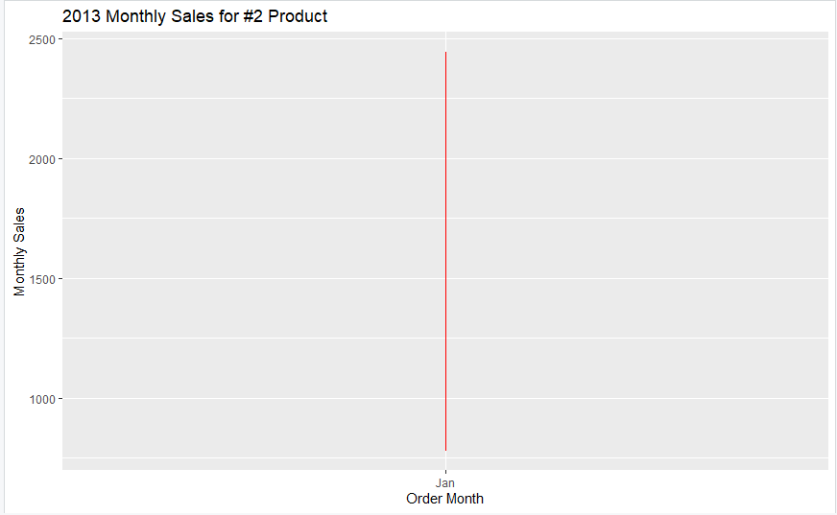
Monthly sales for Product #2 – Line chart

Slide 10

Monthly sales for Product #3 – Line chart

Slide 11
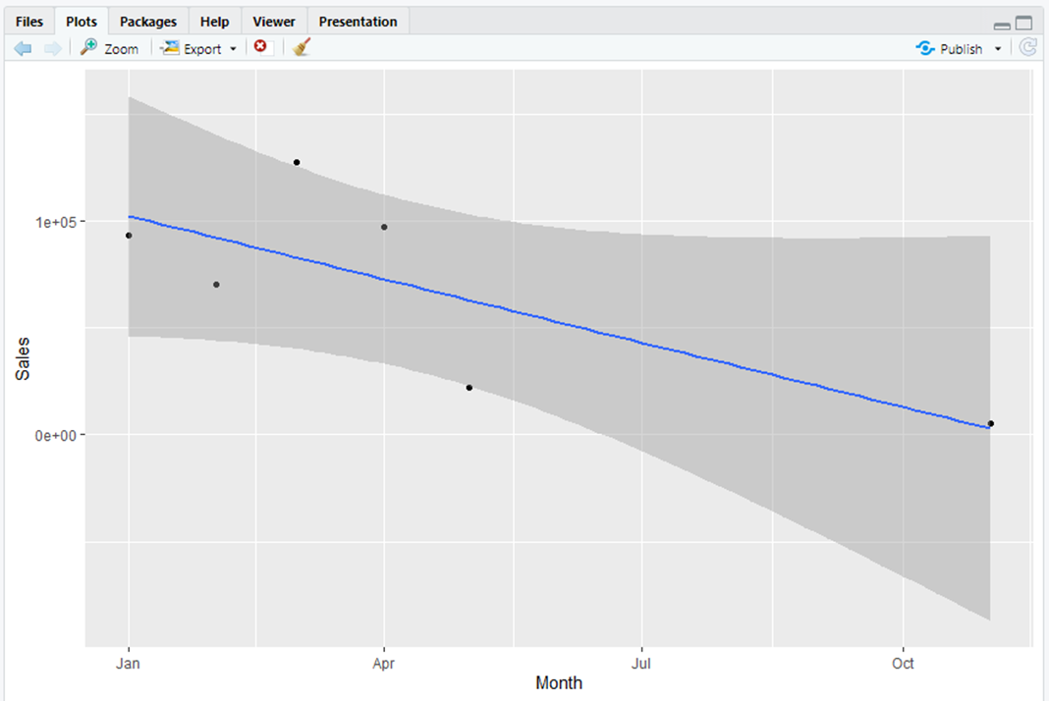
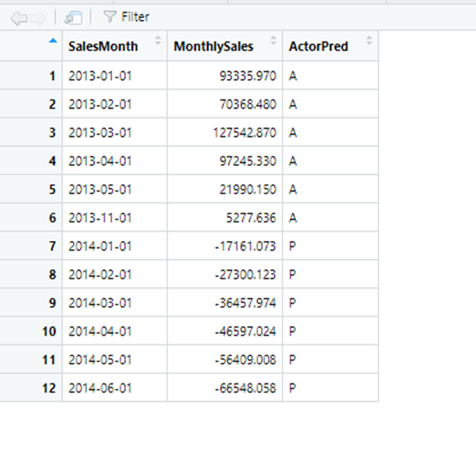
Using 2013 data for Product #1 to generate predictions for Sales Revenue for 2014
Scatter plot for #1 Product by Revenue
Product#1 Prediction for Jan-June 2014

Slide 12
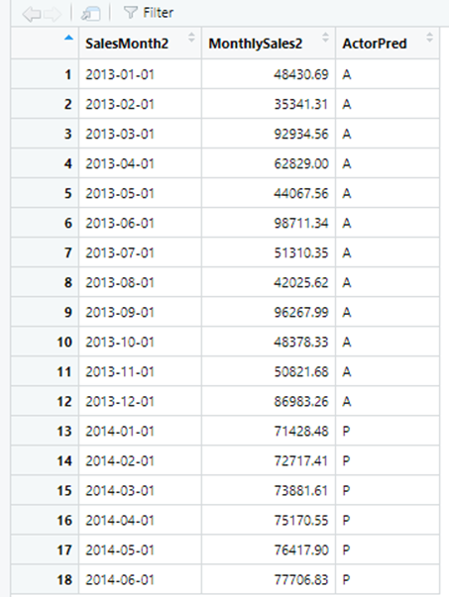
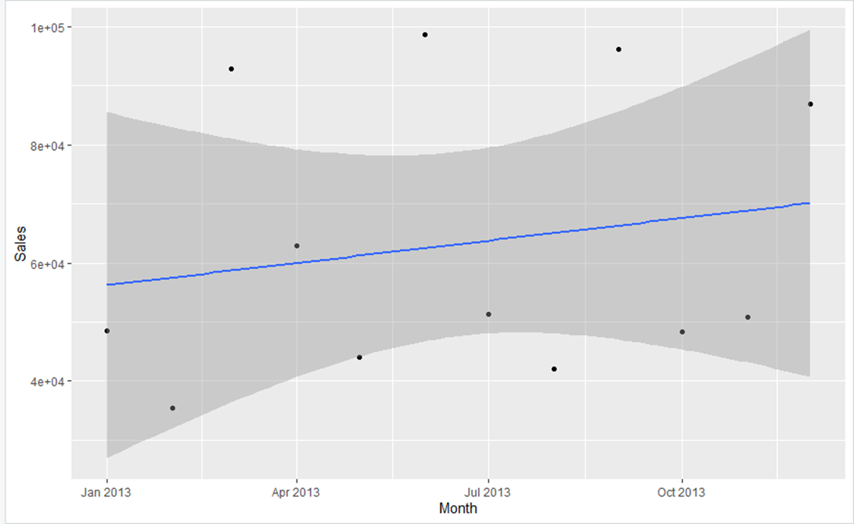
Using 2013 data for Product #2 to generate predictions for Sales Revenue for 2014
Scatter plot for #2 Product by Revenue
Product#2 Prediction for Jan-June 2014

Slide 13
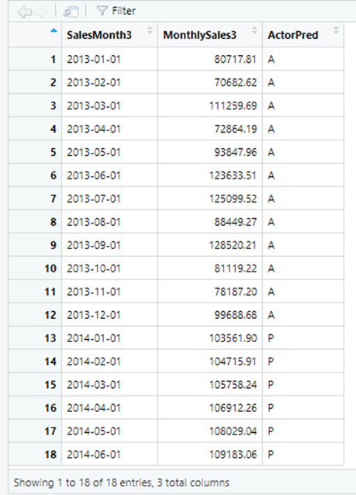

Using 2013 data for Product #3 to generate predictions for Sales Revenue for 2014
Scatter plot for #3 Product by Revenue
Product#3 Prediction for Jan-June 2014

Slide 14
Future Recommendations for top 3 Products
The predictions made for the Product #1 show that it will potentially make losses in the future (2014) and therefore the company can plan to conduct market campaigns for this product in order to boost its sales and avoid future losses.
The predictions made for Product #2 and #3 show that they Sales revenue will slightly increase over the 6 months. This is good but it’s not the best outcome, therefore the sales team could devise innovative means to sell more of these products such as customer incentives.

Slide 15

THANK YOU

